Slide 1

Kashif Ross, MS
Jackie Kokx, MS
Rosie Martinez, ScD, MPH
Rylan Larsen, PhD
Megan Bultema, PhD
Olive4Equity amplifies the voices of Black mothers. We do this by providing remote and integrated blood pressure monitoring in the immediate postpartum period.
Ideas presented here are not an official position of Olive

Slide 2
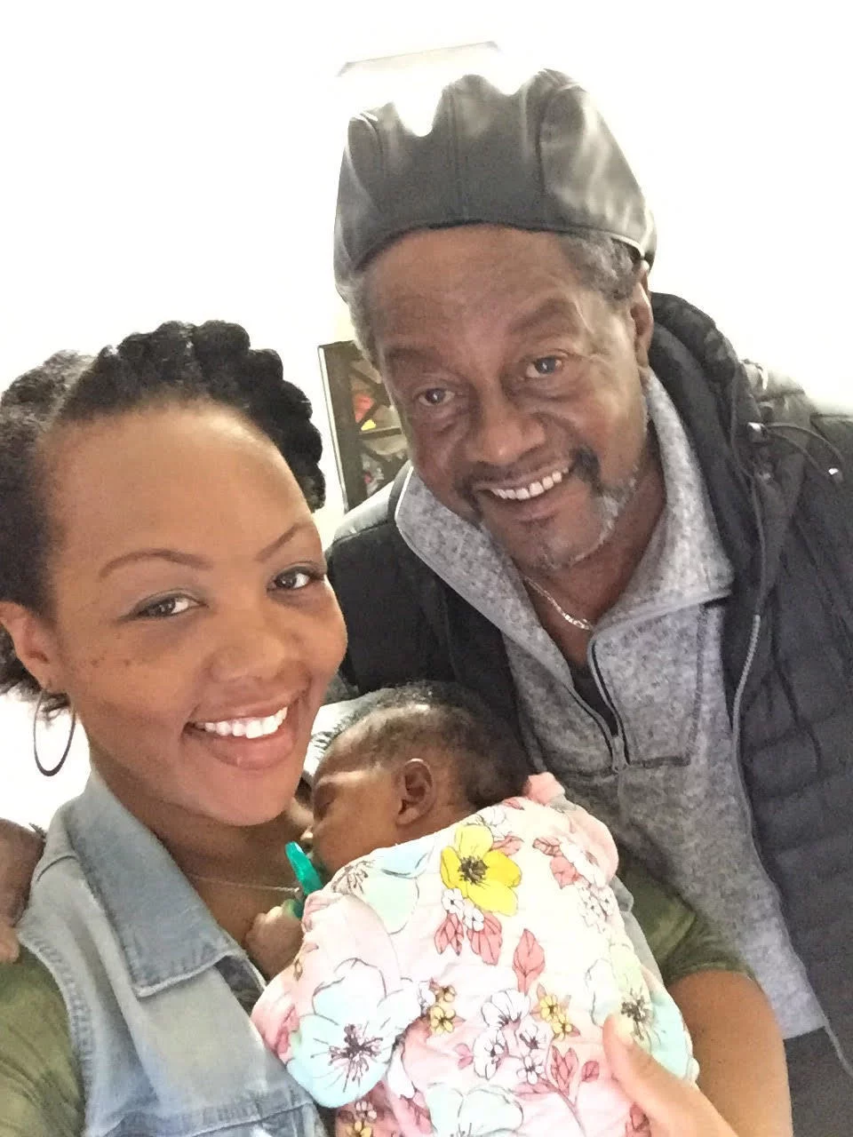
Olive4Equity - Amplify the voices of Black mothers
The problem
Shalon Irving was a 36-yr-old epidemiologist at the CDC, with a dual-subject Ph.D., a gold-plated insurance, and a rock-solid support system died 3 weeks after giving birth due to high blood pressure complications in Georgia.
Notes:
https://www.npr.org/2017/12/07/568948782/black-mothers-keep-dying-after-giving-birth-shalon-irvings-story-explains-why

Slide 3
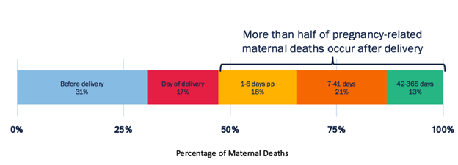
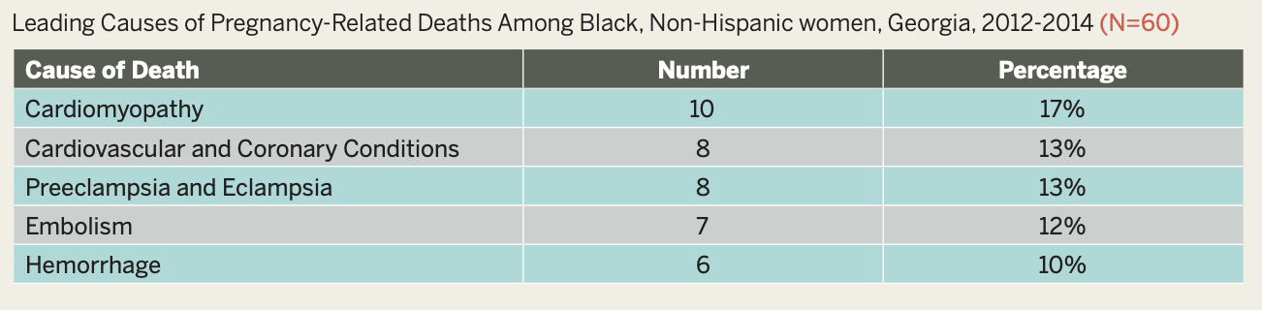
Olive4Equity - Amplify the voices of Black mothers
The problem
Over 50% of pregnancy related deaths occur postpartum
Cardiovascular-related diseases are the leading causes of death for Black mothers in Georgia
Hypertensive disorders of pregnancy, which includes the post-partum period, can lead to immediate and long-term complications
Studies show that providing postpartum at home blood pressure monitoring can reduce time to treatment and frequency of readmission (last slide citations)
Creanga AA, Syverson C, Seed K, Callaghan WM. Pregnancy-related mortality in the United States, 2011-2013. Obstet Gynecol. 2017;130(2):366-73.
https://dph.georgia.gov/sites/dph.georgia.gov/files/related_files/site_page/Georgia%20Maternal%20Mortality%20Report%202014.pdf
https://www.ncbi.nlm.nih.gov/pmc/articles/PMC7289450/
Notes:
Post as an action = given all of this, we belive we can reduce the the burden of these cardiovascular related diseases on maternal mortality through blood pressure monitoring
Georgia is the worst place for Black mothers to give birth in the United States.
They have 4x more likely to die than white mothers
Their voices are more likely to be ignored when expressing pain or requesting additional care
The second leading cause of maternal mortality is high blood pressure. 80% of maternal deaths can be avoided with:
Access to care
Access to information
Timely diagnosis
Right and timely treatment
In the first week postpartum, severe bleeding, high blood pressure, and infection are the most common contributors to maternal deaths, while cardiomyopathy is the leading cause of late deaths.6
https://www.npr.org/2017/12/07/568948782/black-mothers-keep-dying-after-giving-birth-shalon-irvings-story-explains-why
Hoppe, K. K., Thomas, N., Fedenia, K., Zernick, M., Zella, J. B., Shah, D. M., … Johnson, H. (2019). 451: A non-randomized controlled study: Telehealth with remote patient monitoring vs standard care for postpartum hypertension. American Journal of Obstetrics and Gynecology, 220(1). doi: 10.1016/j.ajog.2018.11.472
Hoppe, K. K., Williams, M., Thomas, N., Zella, J. B., Drewry, A., Kim, K., … Johnson, H. M. (2019). Telehealth with remote blood pressure monitoring for postpartum hypertension: A prospective single-cohort feasibility study. Pregnancy Hypertension, 15, 171–176. doi: 10.1016/j.preghy.2018.12.007
Optimizing postpartum care. ACOG Committee Opinion No. 736. American College of Obstetricians and Gynecologists. Obstet Gynecol 2018;131:e140–50.
Hauspurg A, Lemon LS, Quinn BA, Binstock A, Larkin J, Beigi RH, Watson AR, Simhan HN. A Postpartum Remote Hypertension Monitoring Protocol Implemented at the Hospital Level. Obstet Gynecol. 2019 Oct;134(4):685-691. doi: 10.1097/AOG.0000000000003479. PMID: 31503166; PMCID: PMC7289450.

Slide 4
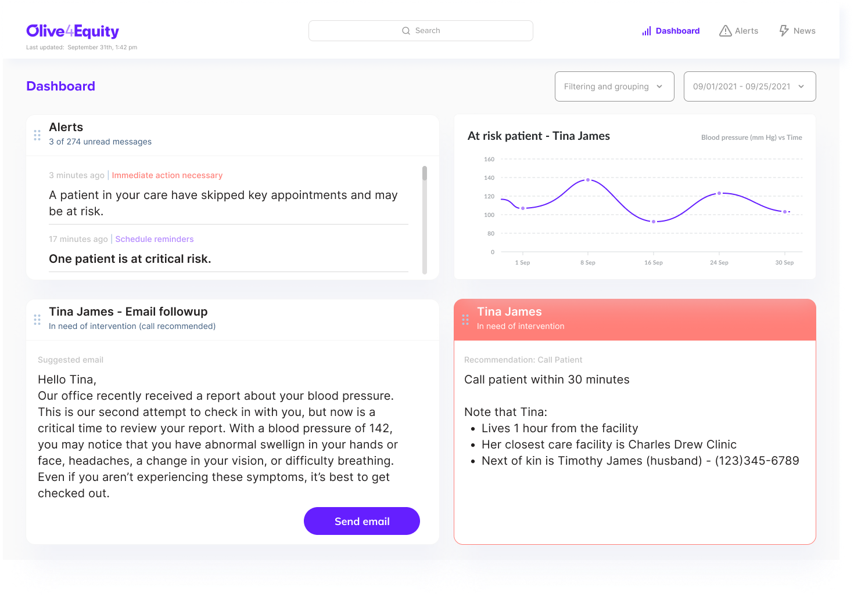
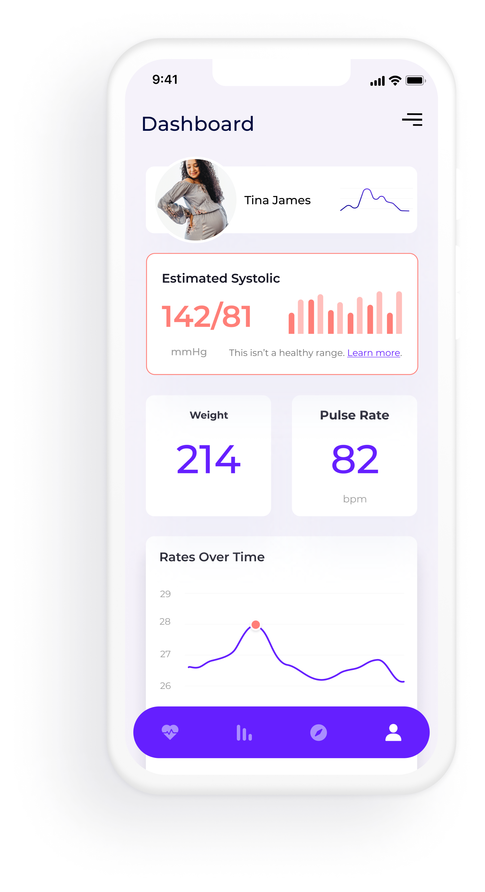
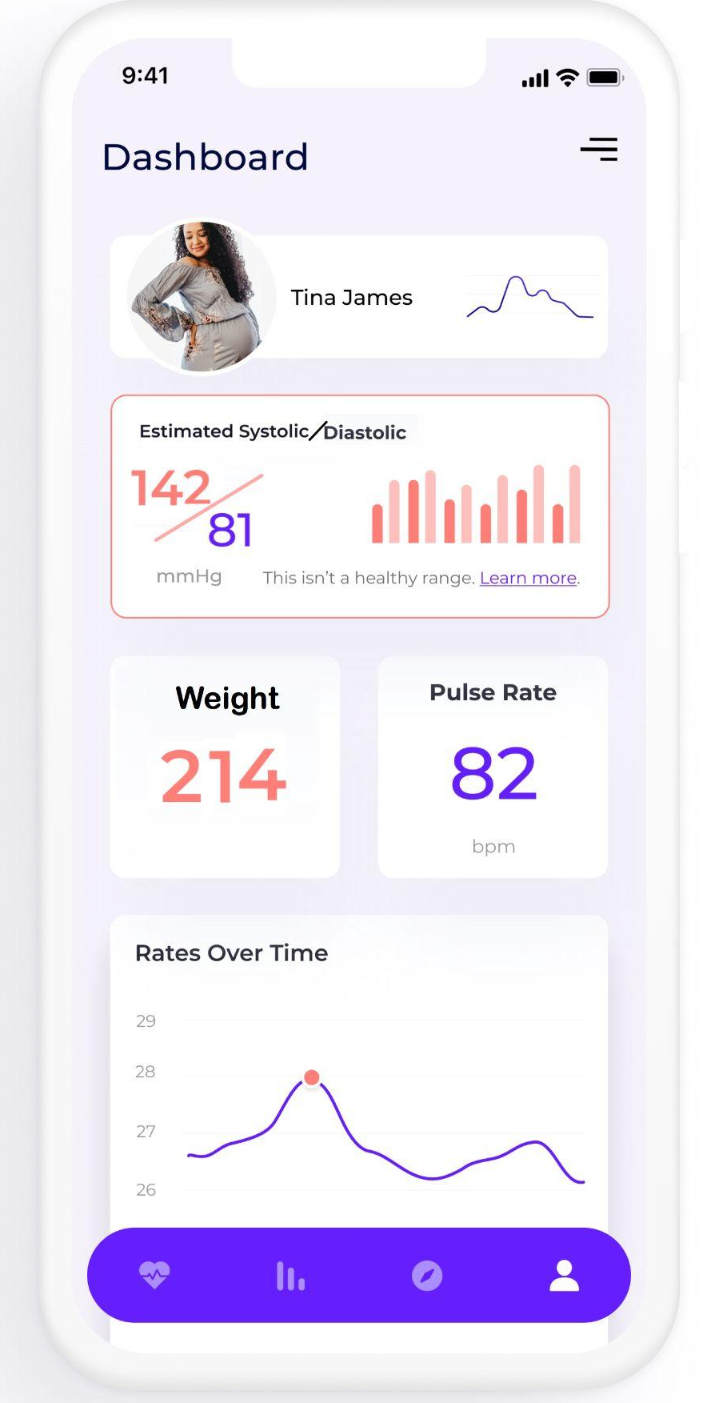
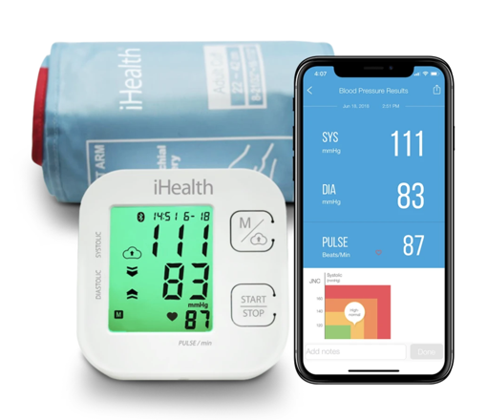
Olive4Equity - Amplify the voices of Black mothers
The Solution: Daily home blood pressure monitoring through mobile devices for early detection of hypertensive signs in Black postpartum mothers integration and alert system for providers.
Notes:
Expansion of an ongoing remote blood pressure monitoring program with demonstrated high compliance, retention, and patient satisfaction to Black mothers in Georgia
Bluetooth enabled blood pressure monitor provided at discharge following birth.
App for automatic connection and transfer of data to provider tracking and alert systems
Payer funded
Expansion of an ongoing remote blood pressure monitoring program with demonstrated high compliance, retention, and patient satisfaction to Black mothers in Georgia
Bluetooth enabled blood pressure monitor provided at discharge following birth.
App for automatic connection and transfer of data to provider tracking and alert systems
Payer funded

Slide 5
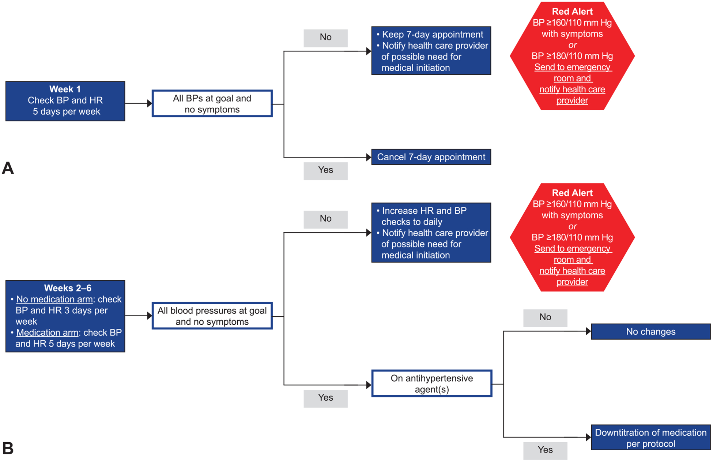
Olive4Equity - Empowering the voices of Georgia’s Black mothers
Pilot Study
https://pubmed.ncbi.nlm.nih.gov/31503166/#affiliation-1

Slide 6
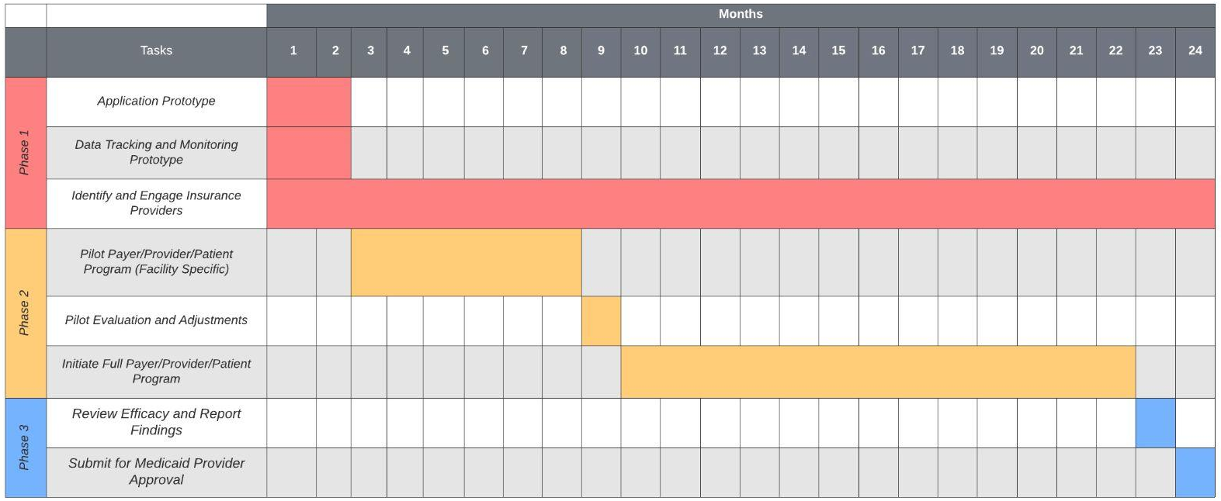
Olive4Equity - Amplify the voices of Black mothers
Implementation
Notes:
We know that this is an issue that impacts mothers across socioeconomic groups. We believe that there is a large financial incentive for payers to support this initiative to reduce acute returns. We want to leverage this interest to fund a year long pilot project in Georgia. We propose to use the findings from that study to drive adoption across medicaid providers.

Slide 7

Olive4Equity - Amplify the voices of Black mothers
Closing
We believe that objective data can amplify Black mother’s voices and save lives like Shalon Irving’s.
Integrating mobile devices with provider systems can provide access to treatment for communities in a care desert.
Daily home blood pressure monitoring in the postpartum period can reduce maternal mortality of Black mothers in the state of Georgia.

Slide 8
References:
Hoppe, K. K., Thomas, N., Fedenia, K., Zernick, M., Zella, J. B., Shah, D. M., … Johnson, H. (2019). 451: A non-randomized controlled study: Telehealth with remote patient monitoring vs standard care for postpartum hypertension. American Journal of Obstetrics and Gynecology, 220(1). doi: 10.1016/j.ajog.2018.11.472
Hoppe, K. K., Williams, M., Thomas, N., Zella, J. B., Drewry, A., Kim, K., … Johnson, H. M. (2019). Telehealth with remote blood pressure monitoring for postpartum hypertension: A prospective single-cohort feasibility study. Pregnancy Hypertension, 15, 171–176. doi: 10.1016/j.preghy.2018.12.007
Optimizing postpartum care. ACOG Committee Opinion No. 736. American College of Obstetricians and Gynecologists. Obstet Gynecol 2018;131:e140–50.
Hauspurg A, Lemon LS, Quinn BA, Binstock A, Larkin J, Beigi RH, Watson AR, Simhan HN. A Postpartum Remote Hypertension Monitoring Protocol Implemented at the Hospital Level. Obstet Gynecol. 2019 Oct;134(4):685-691. doi: 10.1097/AOG.0000000000003479. PMID: 31503166; PMCID: PMC7289450.
Van Den Heuvel JFM, Lely AT, Franx A, Bekker MN. Validation of the iHealth Track and Omron HEM-9210T automated blood pressure devices for use in pregnancy. Pregnancy Hypertens. 2019 Jan;15:37-41. doi: 10.1016/j.preghy.2018.10.008. Epub 2018 Nov 2. PMID: 30825925.

Slide 9
Olive4Equity - Amplify the voices of Black mothers
Advantages for Providers
Benefits for Black Mothers
View of blood pressure during daily activities
More blood pressure readings to support diagnosis
More timely diagnosis
Access to care from home
Relevant information
Black mother empowerment
Gather evidence to demand care
Reduced risk of exposure to Covid-19
Benefits for Payer Systems (Insurance, Medicaid)
Reduce occurence of costly readmissions

Slide 10
Olive4Equity - Amplify the voices of Black mothers
Value of Olive4Equity
Benefits for Black Mothers
Access to care from home
Relevant information
Black mother empowerment
Gather evidence to demand care
Reduced risk of exposure to Covid
Benefits for Providers
View of blood pressure during daily activities
More blood pressure readings to support diagnosis
More timely diagnosis
Benefits for Payer Systems (Insurance, Medicaid)
Reduce occurence of costly readmissions
Benefits | Olive4Equity | The Cuff Project The Preeclampsia Foundation
Validated BP Device | Yes | Yes
BP Data Sent to Provider | Automatically | Manually
Educational Information Provided | Yes | Yes
Designated Medical Support Call Center | Yes | No
Funding | Insurance Providers | The Preeclampsia Foundation
Published Pilot Program | Yes | No

